Slide 1

MOBILE PRICE PREDICTION AND FEATURE EXTRACTION
Aishwarya Kumar Singh
Intern – Nexthikes IT Solution
Saturday, November 15, 2025

Slide 2
Agenda
Introduction
Primary Goals
Data Load
EDA Process
Notebook: mobile_price_prediction.ipynb
Feature Extraction
Report and Summary
Presentation Title

Slide 3

Introduction
This project predicts mobile phone prices based on features collected from an e-commerce dataset. The notebook performs data cleaning and preprocessing(EDA), feature selection, model building, evaluation, and exports plots and artifacts.
This helps in coming to a conclusion of mobile prices based on various features and that caters the future requirements and price predictions.

Slide 4


Primary goals Build reliable regression models to predict mobile prices. Identify most influential features affecting price. Create reproducible outputs: cleaned dataset, plots, model artifacts, and a short report. Provide actionable visualizations for stakeholders.
Mobile
data
analysis

Slide 5
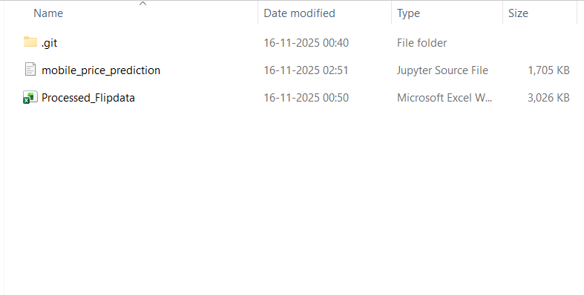
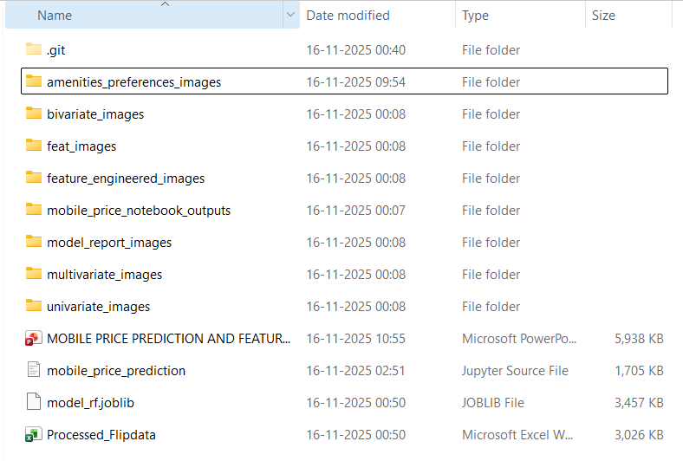
Folder Structure & Analysis Report Screenshots
Before EDA and feature extractions
After EDA and feature extractions

Slide 6
Folder Structure
mobile-price-prediction/ # project root
├─ mobile_price_prediction.ipynb # main analysis notebook
├─ Processed_Flipdata.xlsx # raw/processed workbook
├─ mobile_price_notebook_outputs/ # outputs (plots, models, CSVs, and logger file)
├─ univariate_images/ # outputs (univariate analysis resultant graph images)
├─ bivariate_images/ # outputs (bivariate analysis resultant graph images)
├─ multivariate_images/ # outputs (multivariate analysis resultant graph images)
├─ feature_engineered_images/ # outputs (feature engineered output graph images)
├─ feat_images/ # outputs (images generated through final feature reports)
├─ model_report_images/ # outputs (model images generated through reports)
├─ ameneties_preferences_images/ # outputs (ameneties preferences images)
NOTE: The full folder structure appears only after EDA and feature extraction completion

Slide 7
“Without data, you’re just another person with an opinion.”
W. Edwards Deming

Slide 8

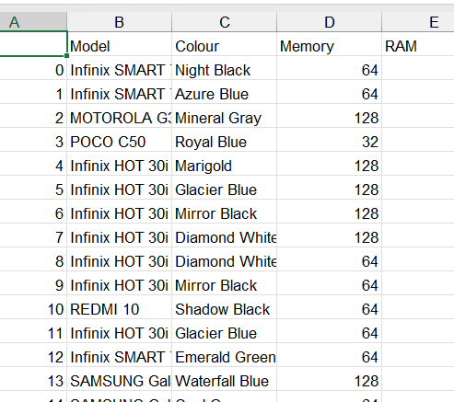

Data Overview
Key columns
Brand, Model, RAM, Storage, Battery, Camera, Price, etc.
Source: Processed Dataset
Data types
(Processed_Flipdata.xlsx).
Numerical and categorical features

Slide 9




Data Cleaning and Pre-processing
Handling missing values
Standardizing column names and formats
Encoding categorical variables
Feature Engineering for improved prediction accuracy

Slide 10
Exploratory Data Analysis(EDA)
Preview the Dataset
Data Summary
Checking Missing Values
Data Cleaning with Pandas
Clean Dataset & Handle Outliers
Using head() and tail(), one can preview the data and get idea what is all that is included in the dataset
Data summary can be viewed using info() method
It will check the missing values in features with percentage
Data cleaning and identifying the duplicate values
This ensures data quality by eliminating missing values, removing, and addressing any anomalies or inconsistencies in the dataset.

Slide 11
Exploratory Data Analysis(EDA)
Analysis Methods
Feature Engineering
Univariate analysis: distribution of prices, RAM, storage, battery
Bivariate/Multivariate analysis: correlations between features and price
Visualizations: histograms, boxplots, scatter plots, bar charts
Introduces new variables that might enhance the model's ability to predict house prices.
Identified most impactful features on price:
RAM & Storage
Brand influence
Camera quality
Battery capacity

Slide 12
Tools and Libraries
Visualization
Machine Learning
Matplotlib 📊 – A versatile plotting library in Python that enables the creation of a wide range of static, animated, and interactive visualizations.
Seaborn 🎨 – A statistical data visualization library built on Matplotlib, making it easy to create attractive and informative plots with minimal code.
It is widely used machine learning library for providing simple, and efficient tools that are used for preprocessing, modelling, evaluation, and prediction.
Data Manipulation
Pandas 🐼
NumPy 🔢 – The core numerical computing library in Python, providing fast array operations, mathematical functions, and the foundation for scientific computing.
Data Cleaning
Styling
Pandas 🐼 – A powerful Python library for data manipulation and analysis, offering intuitive DataFrame structures to clean, transform, and explore datasets efficiently.
openpyxl 📘 – A Python library to read, write, and style Excel (.xlsx) files, enabling automated reporting, formatting, and multi‑sheet data exports directly from code.

Slide 13

Analysis and Graphs
Univariate Analysis
Explored single features’ distributions, central tendency, and spread using histograms, bar plots, and boxplots to detect skewness and outliers.
Bivariate Analysis
Examined relationships between two variables with scatter plots, correlation heatmaps, and grouped bar charts to identify trends and associations.
Multivariate Analysis
Analyzed interactions among multiple features using pair plots, heatmaps, and 3D scatter plots to uncover deeper patterns and dependencies.
Outlier Detection
Identified extreme values through boxplots and IQR whiskers, then capped or adjusted them to prevent skewed insights in downstream analysis
Missing Value Analysis
Assessed missingness patterns with heatmaps and bar charts, then applied imputation or feature dropping strategies for reliable, consistent datasets.

Slide 14
Workbook & Plot/Graphs using Python Code
Mobile Data
Code overwrote the main sheet with cleaned DataFrame, applied formatting, adjusted column widths, and saved reliable, analysis‑ready dataset.
Excel workbook and its worksheets were created using code, with each sheet uniquely capturing specific analysis results, ensuring automation, transparency, and reproducibility throughout.
Excel sheets were directly updated in the workbook once any analysis is completed and workbook can be reopened to see the sheets those were added.
To see the graphs and the worksheets, one needs to wait for generation of the images(plots/graphs) and the workbook. Once done, they can be seen in the respective folders and workbook.
Outlier Report (Numeric)
Code calculated outliers using IQR, logged capped values into a new sheet, and styled table for transparent stakeholder reporting.
Missing Value Analysis
Code computed missing percentages per feature, exported results into a styled sheet, enabling quick visualization of data quality issues.
Numeric Feature Summary
Table to describe the features with numerical statistics associated with each one of them.
Code Importance
Code helps in automating the tasks. All sheets were created dynamically using python code, which shows data can be analyzed much better way using code, rather than doing it manually to adjust in the workbook.

Slide 15
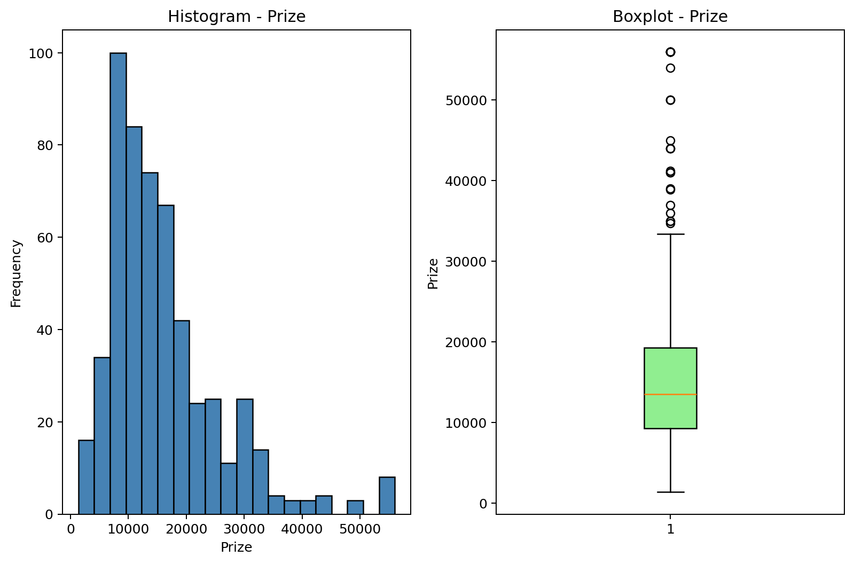
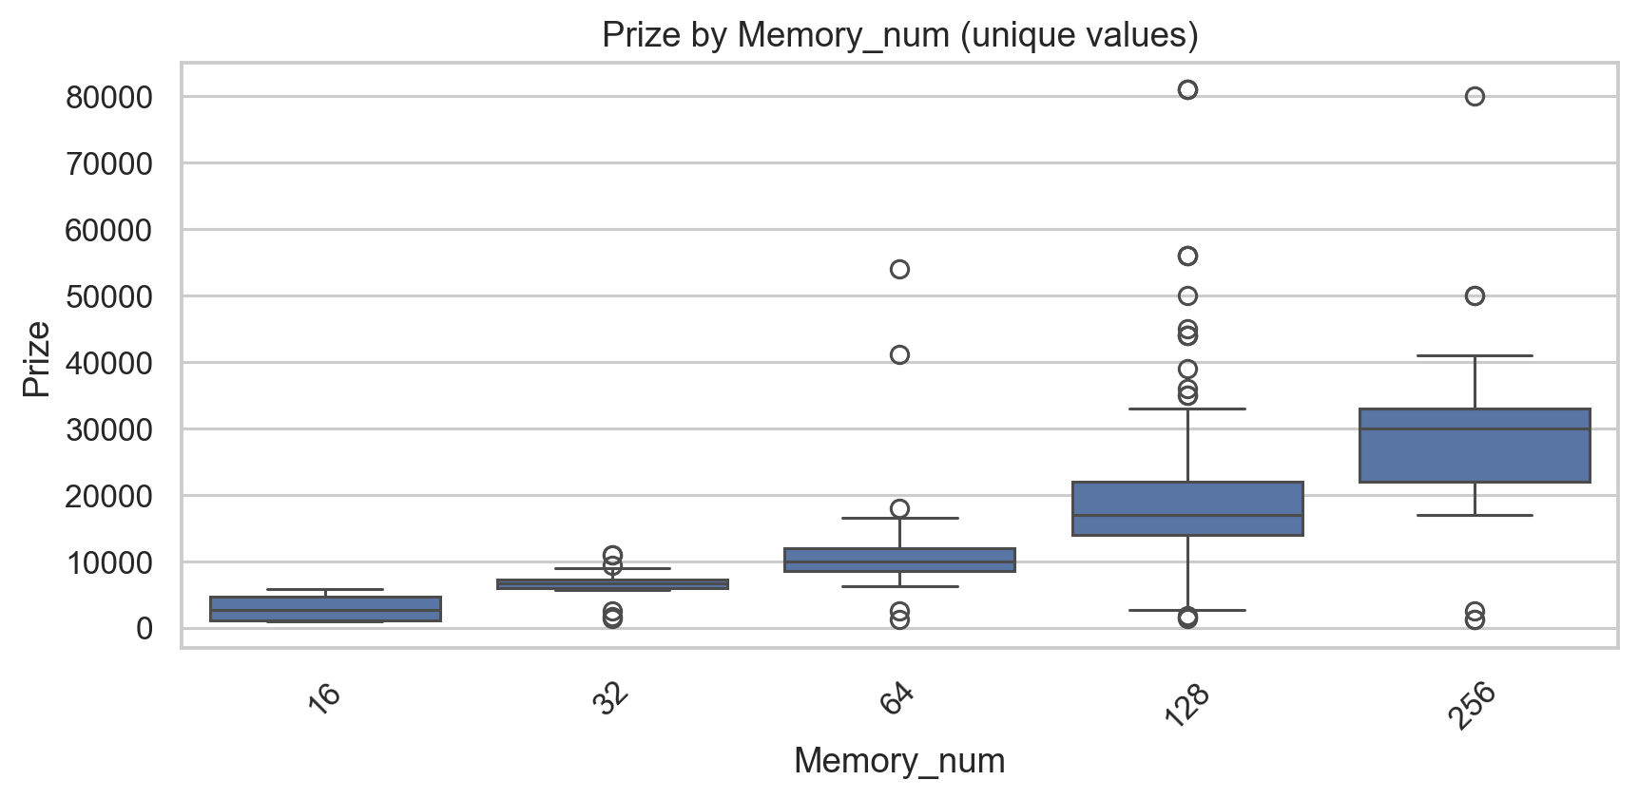
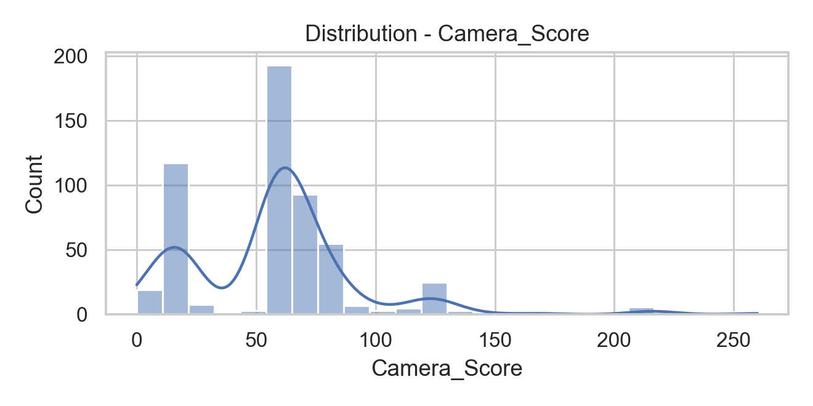
Screenshots

Slide 16


Summary
Systematic data analysis reveals key patterns in mobile price predictions.
Helps stakeholders make informed, data-driven decisions.
Next steps:
Advanced modeling
Regional segmentation
Time-based price trend analysis
Project performs all the analysis to deliver the results for taking decisions based on the numeric data and statistics.

Slide 17




Thank You
Aishwarya Kumar Singh
github.com/aishks14

